Slide 1


SMART INDIA HACKATHON 2025
TITLE PAGE
Problem Statement ID – 25049
Problem Statement Title- Al-Driven Public Health Chatbot for Disease Awareness
Theme- MedTech / BioTech / HealthTech
PS Category- Software/Hardware
Team ID-
Team Name (Registered on portal) - EMAA

Slide 2
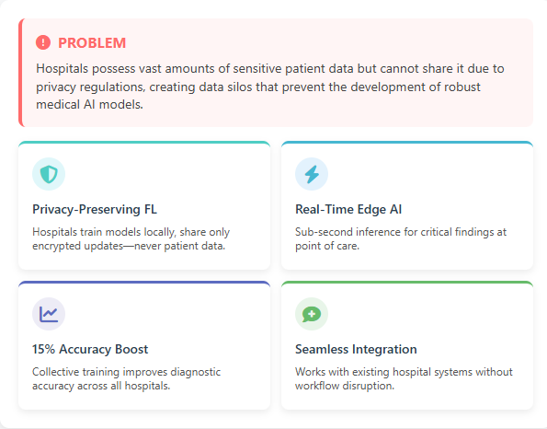
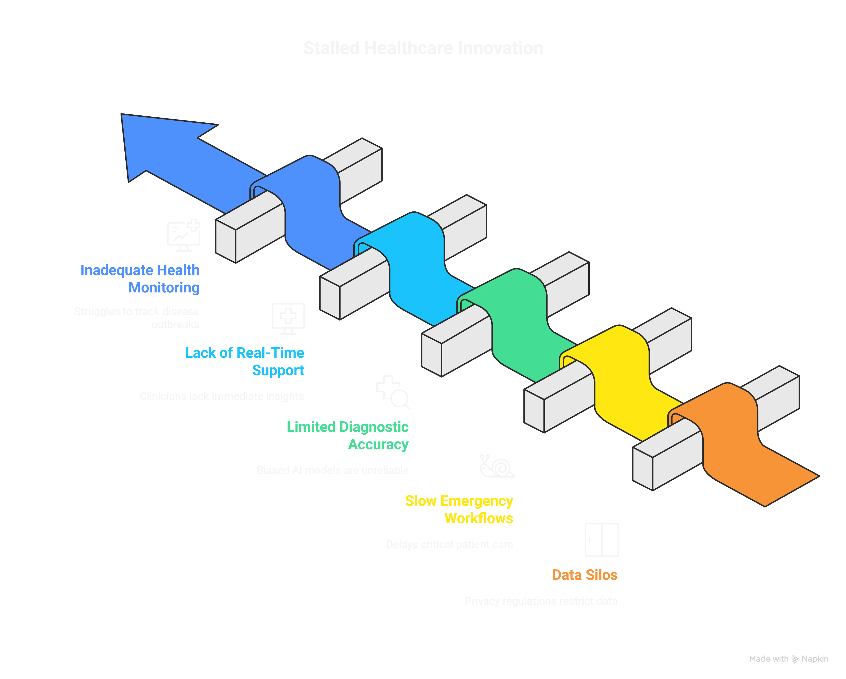
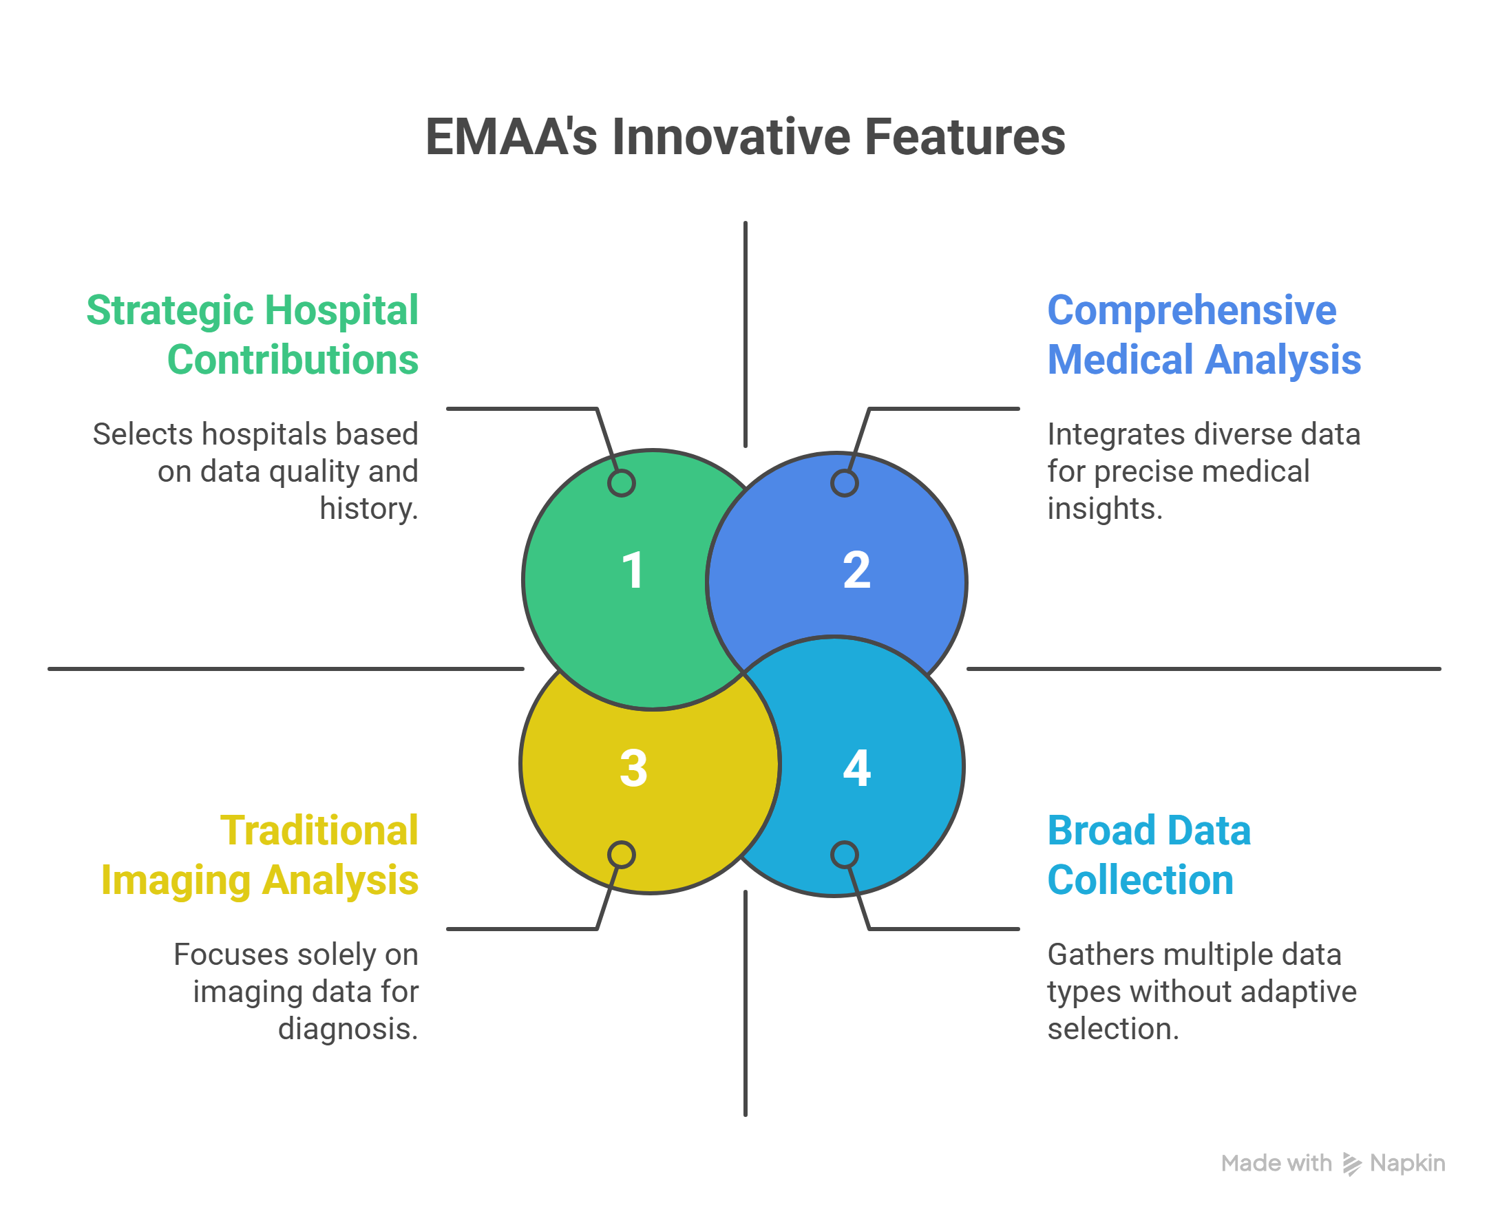
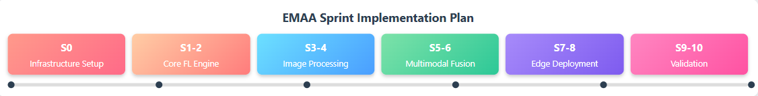
EMAA: Emergency Medical AI Advisor Federated Learning Platform for Healthcare Innovation Advanced Healthcare AI • Privacy-First Architecture • Scalable Deployment
EMAA
IDEA / SOLUTION :
EMAA (Emergency Medical AI Advisor) introduces a revolutionary federated learning platform for privacy-preserving healthcare AI collaboration.
Privacy-Preserving Federated Learning: Hospitals train models locally; only encrypted updates are shared, ensuring data privacy compliance.
Multilingual Accessible Chatbot: Available via WhatsApp/SMS in local languages for rural populations without internet or smartphones.
Real-Time Outbreak Alerts & Vaccination Reminders: Informs users about local outbreaks and upcoming vaccinations using government health database integration.
Symptom Checker & Preventive Guidance: Provides accurate advice on symptoms, hygiene, and disease prevention to reduce early-stage spread.
Efficient & Scalable Deployment: Uses LoRA for reduced model size and supports thousands of simultaneous users in low-resource areas.
Problem Resolution :
Unique Value Propositions (UVP) :
Comprehensive Multimodal AI: Integrates imaging, lab results, vitals, and clinical notes for accurate, holistic disease analysis.
Adaptive Federated Learning: Uses Shapley value-based client selection for efficient, high-quality model training from diverse hospitals.

Slide 3
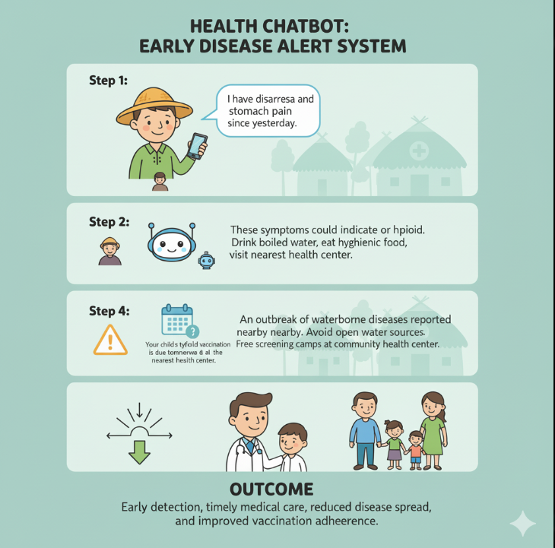
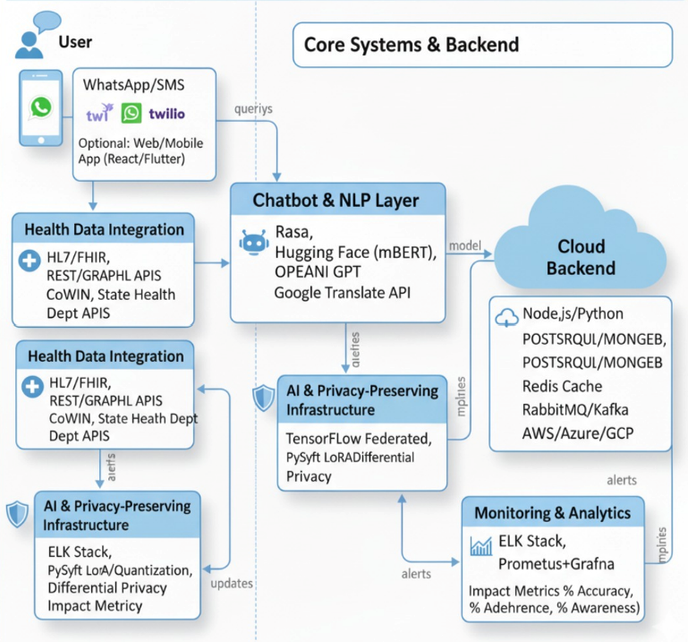
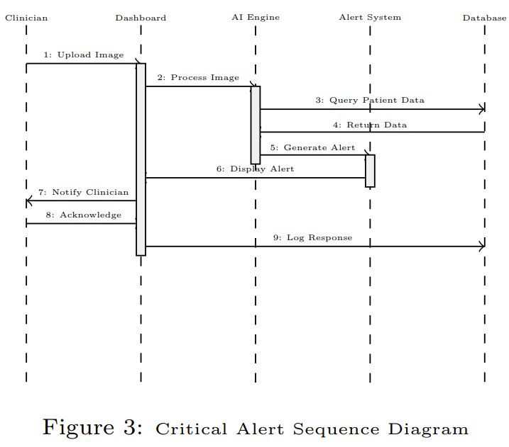
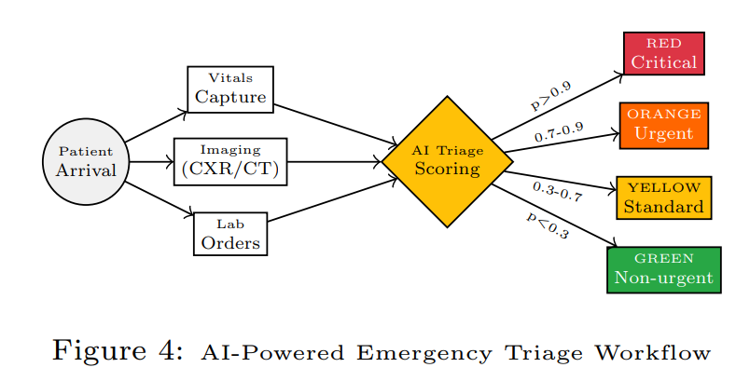
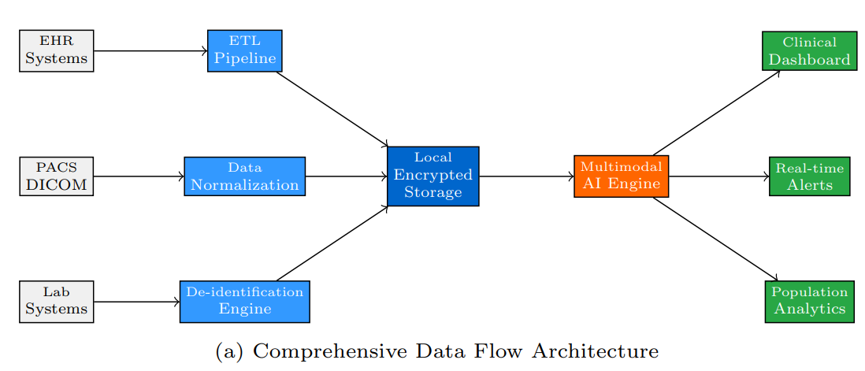
TECHNICAL APPROACH Leveraging Federated Learning and Edge Computing for Privacy-Preserving Medical AI
EMAA
TECHSTACKS
PROCESS FLOW ARCHITECTURE

Slide 4
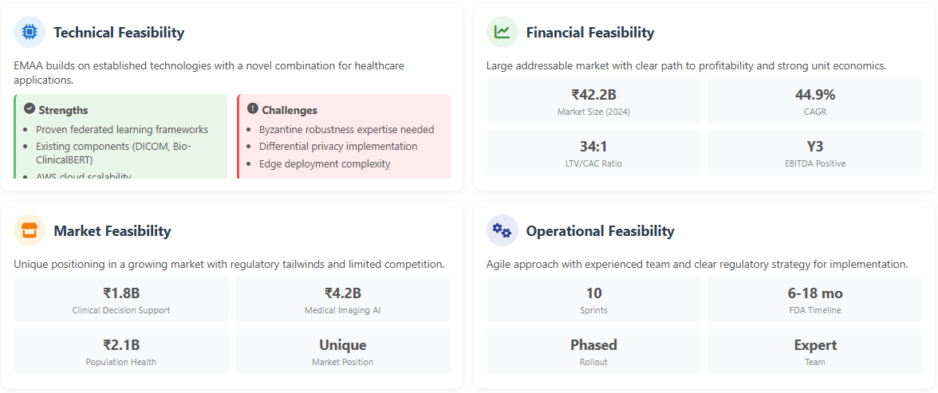
FEASIBILITY AND VIABILITY Assessing practicality before pursuing possibility
EMAA

Slide 5
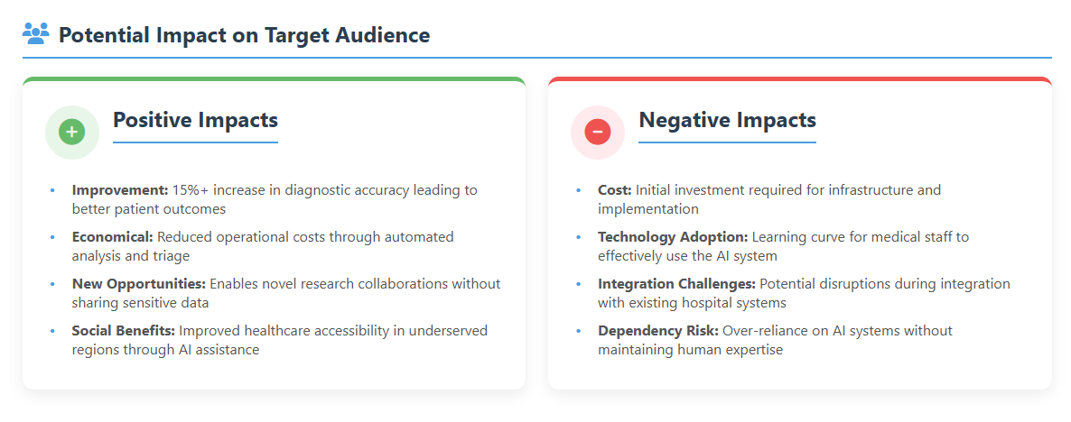
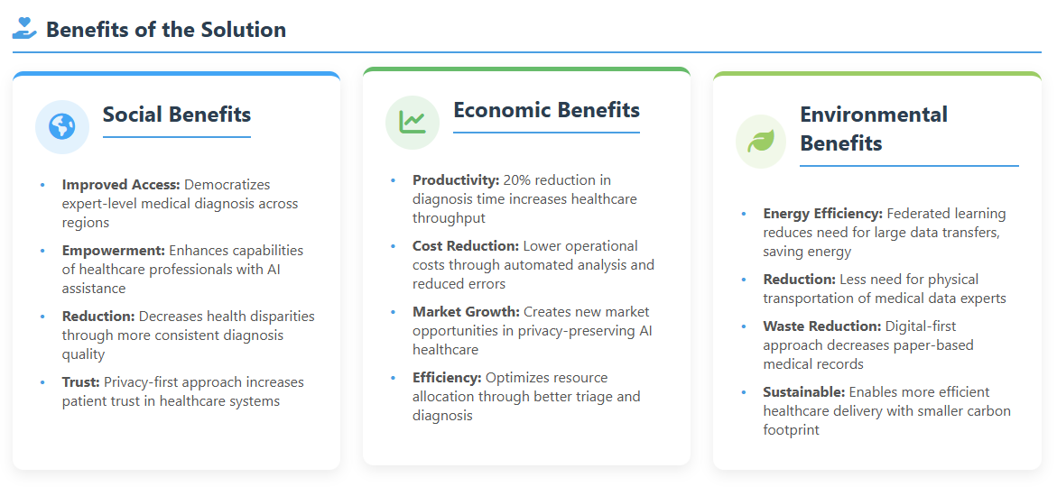
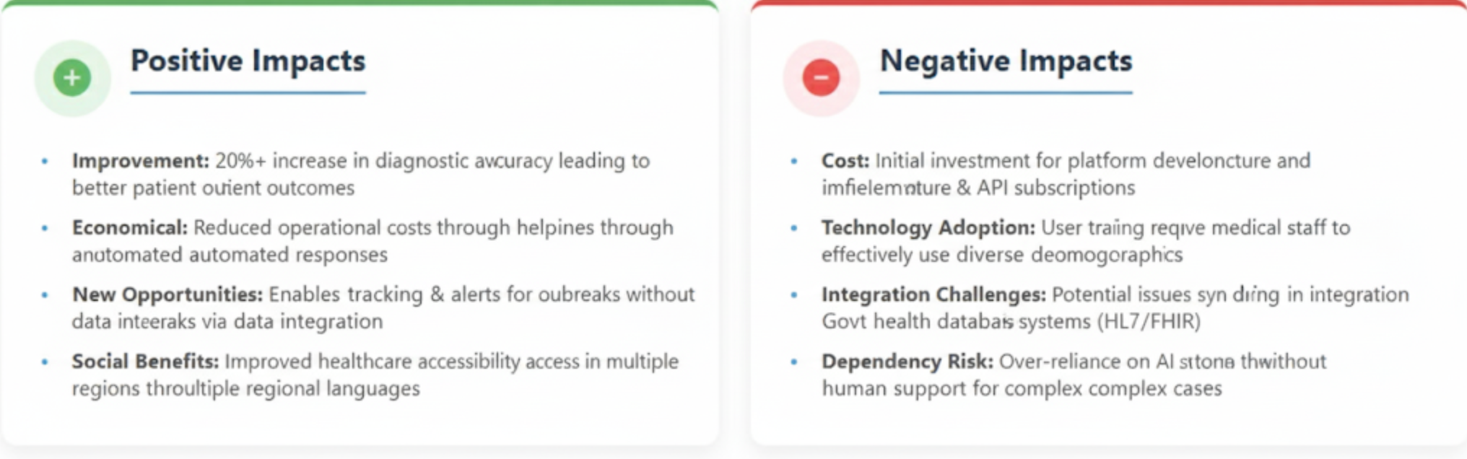
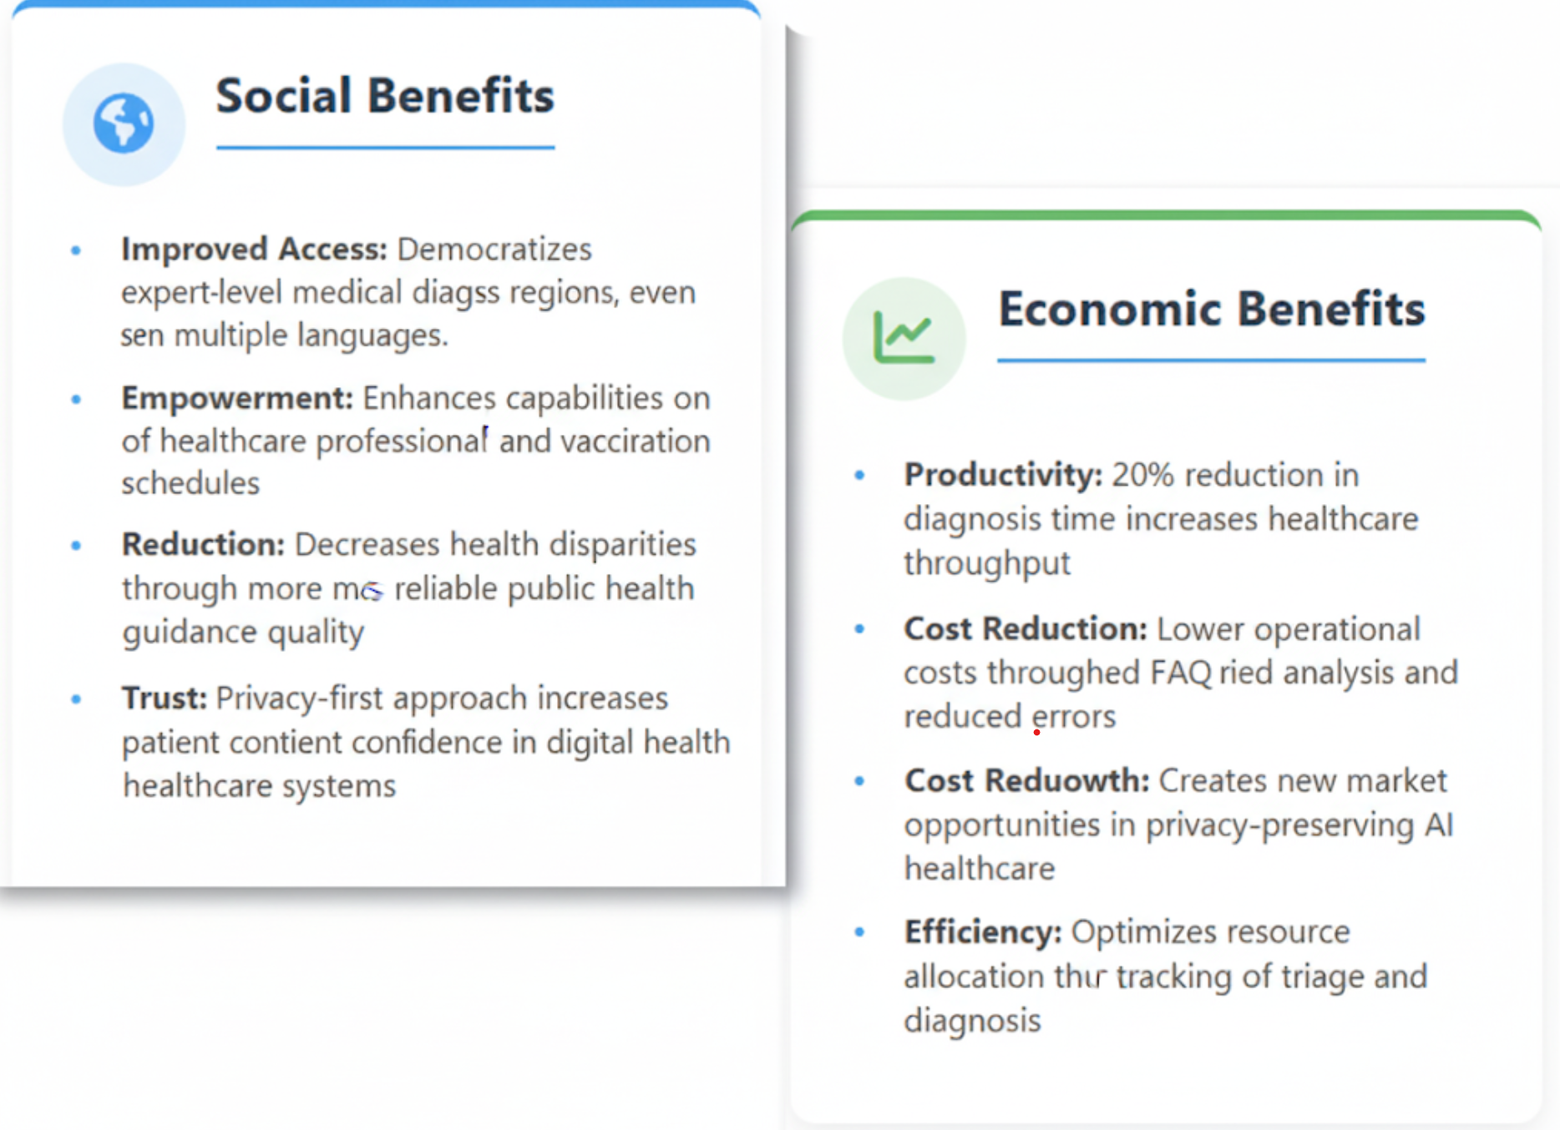

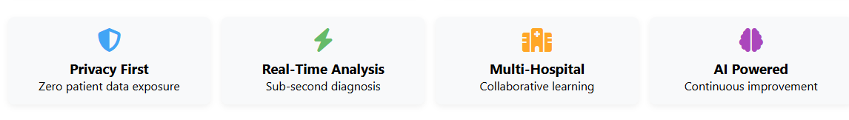
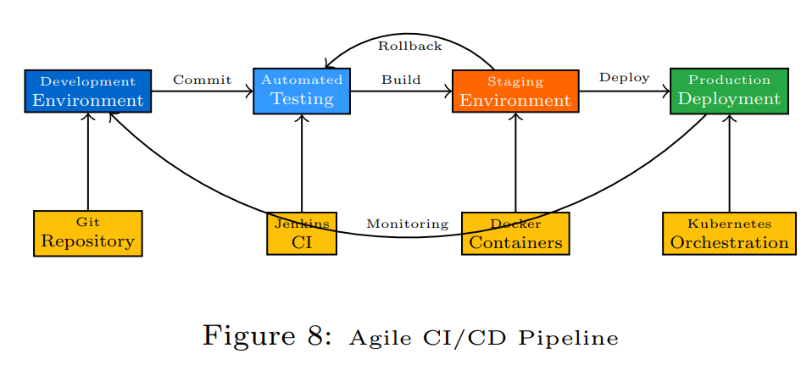
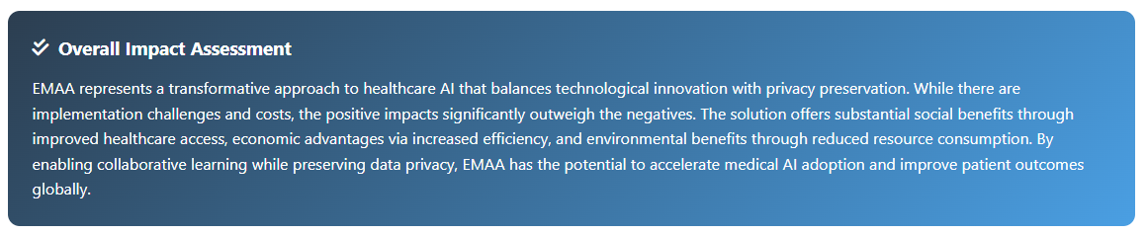

IMPACT AND BENEFITS Translating efforts into measurable value
EMAA

Slide 6
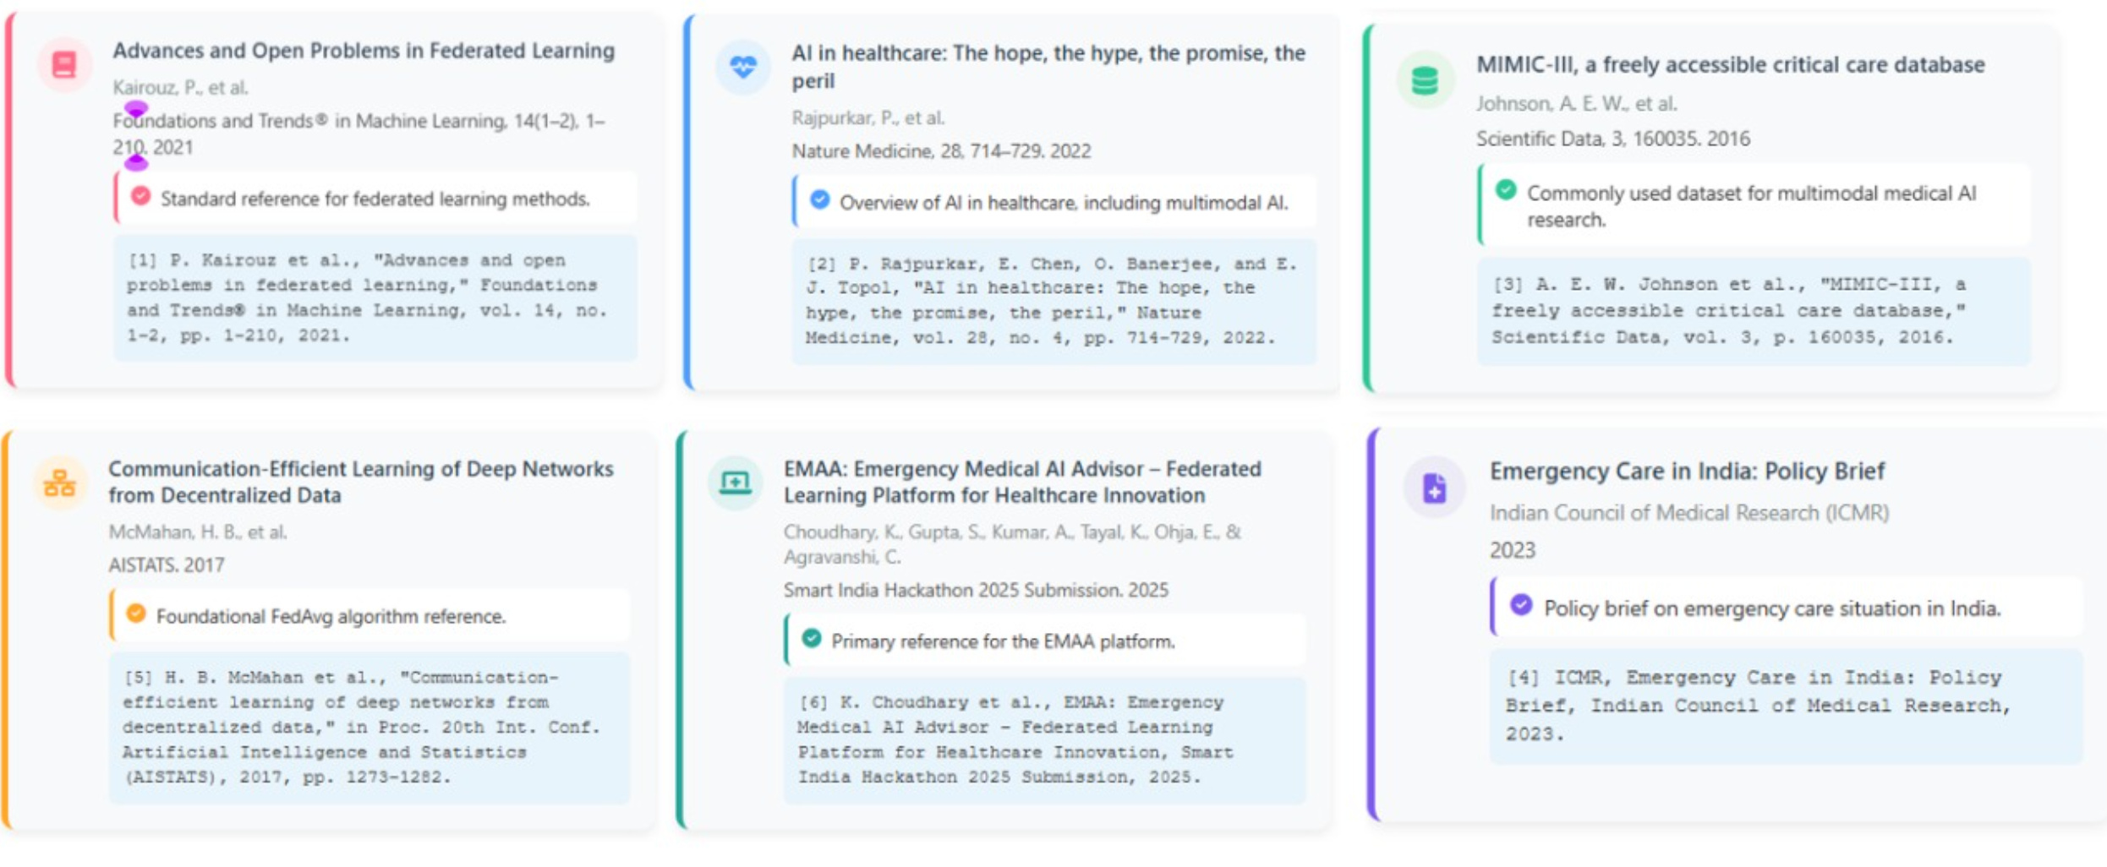
RESEARCH AND REFERENCES Grounded in facts, guided by evidence
EMAA

